Slide 1
Api Marketplace “Categorization”
1 | Description
2 | Terminologies
3 | Key Features
4 | Process Workflow
5 | Key Inputs/Outputs

Slide 2
Description

Slide 3
Descriptions
What is the API Marketplace?
A centralized platform that exposes APIs from ARG subsidiaries in a unified, secure, and standardized way
What is Bulk Categorization?
An AI-powered service that classifies a bulk list of merchants into predefined business categories.
Customers can review, confirm, and modify classifications when required.
What Bulk Categorization Does:
Automatically classifies merchants using AI.
Allows customers to update or adjust results if needed.
How It Will Be Used (B2B Context):
Subsidiaries integrate with the API Marketplace to offer this service via digital channels.
Advantages (Business View):
Provides accurate classification without building a new AI solution.
Supports bulk processing to save time and effort.
Standardized and secure access through API Marketplace.
Faster time-to-market and centralized monitoring.
How It Works (Business Flow):
Customer submits bulk merchant details → API Marketplace validates and routes → Categorization Service processes via AI → Results returned to the customer.

Slide 4
Terminologies

Slide 5
Terminologies- Business Definitions
Bulk Categorization | An AI-powered service that classifies multiple merchants into categories based on business type and transaction data.
API Marketplace | Validates requests, applies security, and routes them to the Categorization Service.
Categorization | Assigning merchants into predefined business categories (e.g., Food & Beverage, Electronics, Retail)
Provider (Categorization Service) | Backend categorization engine that processes merchant lists.
Consumer | Subsidiary using the service.
Customer | End user interacting with the categorization service.
1 9

Slide 6


Key Features – Business Perspective

Slide 7
Key Features
1. Categorization Capabilities
Ability to classify a bulk list of merchants in a single request.
Automatic classification into predefined categories using AI.
Support for multiple merchant attributes (name, type, transaction data).
Fast response time (2–5 seconds) even for high volumes.
2. Review & Update Capabilities
Customers can review classification results through the digital channel.
Option to correct or update classifications before confirmation.
Immediate reflection of updates in the system.
Audit trail maintained for transparency and compliance.
3. Integration & Access
Standardized API exposure through the API Marketplace.
Secure access with OAuth 2.0 authentication and authorization.
Scalable to support growing transaction volumes.
Consistent classification logic across subsidiaries.
4. Reporting & Notifications
Real-time confirmation with unique request reference IDs.
Status tracking for categorization requests (in-progress, completed, failed).
Exportable categorized lists for reporting and analysis.
Centralized notifications and logs for monitoring and audits.

Slide 8
Process Workflow

Slide 9
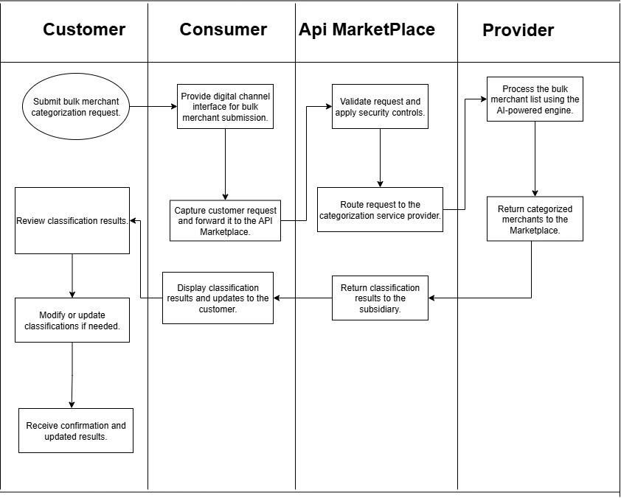

Slide 10
USECASES
Customer
Consumer
API Marketplace
Provider
Submit request
Review results
Forward request.
Show Results
Validate & secure
Route to Provider
Process merchants
Return results

Slide 12
Inputs & Outputs – Business Keys

Slide 13
Purpose: Explain what the client needs to provide and what they will get from the APIs.
Inputs (Business Perspective):
Bulk list of merchants (customer provided)
Outputs (Business Perspective):
Categorized list of merchants (AI processed)
Updated classifications if modified

